Slide 1
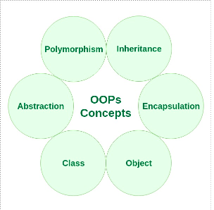
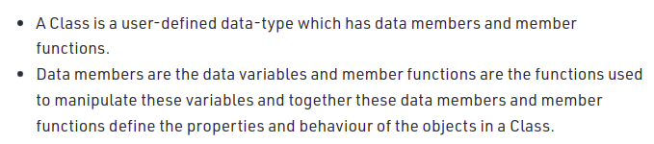

Slide 2


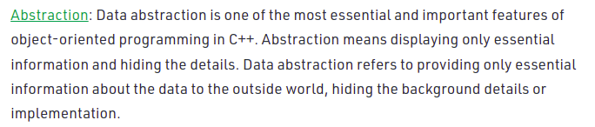
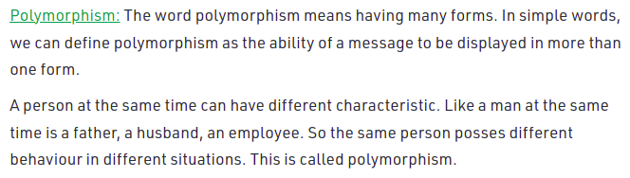

Slide 3
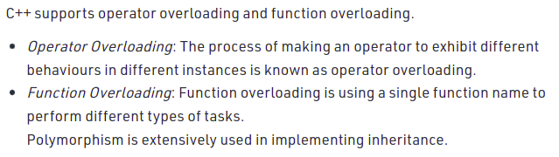
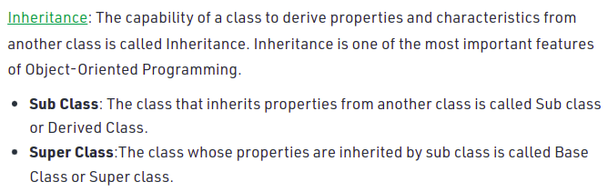

Slide 4
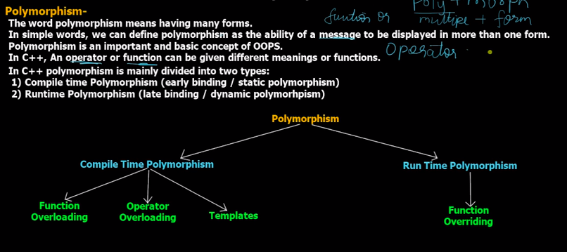

Slide 5
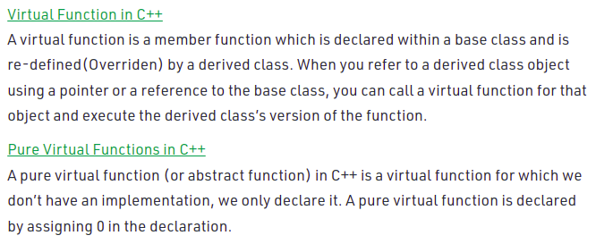
These functions can’t be global or static.
Virtual functions allow us to create a list of base class pointers and call methods of any of the derived classes without even knowing the kind of derived class object.

Slide 6
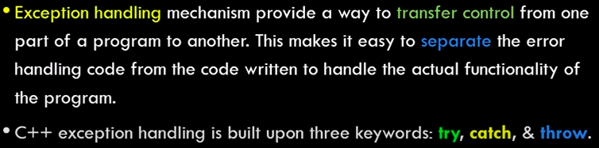
C++ has
1. Call by value
2. Call by reference
3. Call by address/ pointers
While in c, we have
1. call by value
2. call by pointers(it is called reference there)

Slide 7
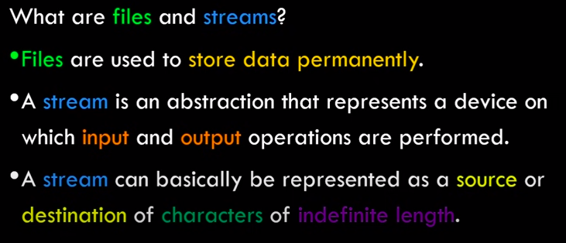
IOS
| ifstream
|--istream
| iostream
|--ostream
ofstream
fstream

Slide 8
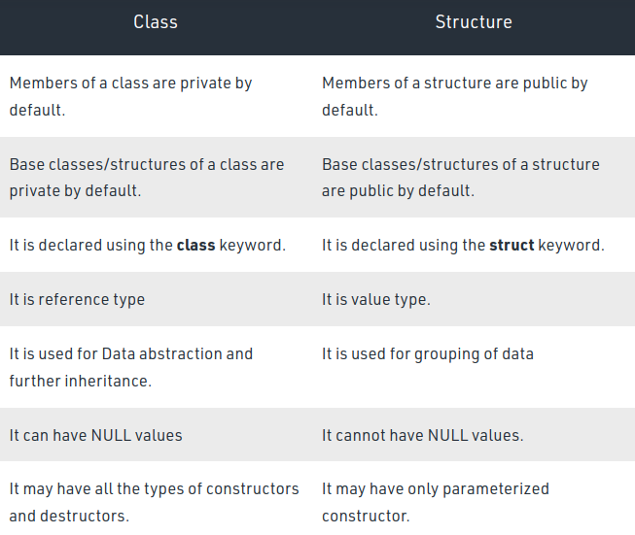

Slide 9
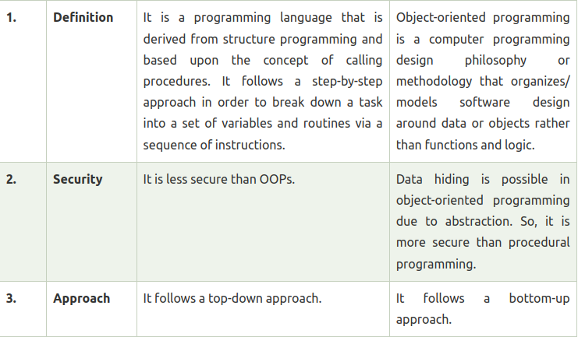

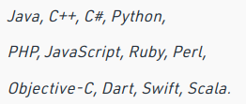
Procedural Object Oriented
Programming Programming

Slide 10
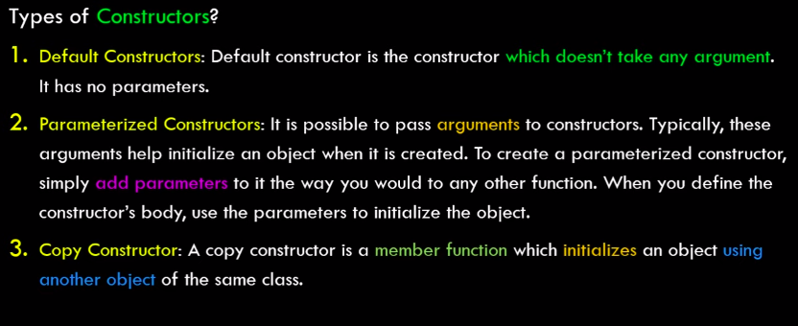

In java, there is no default copy constructor.
Default copy constructor does a shallow copy of members.

Slide 11
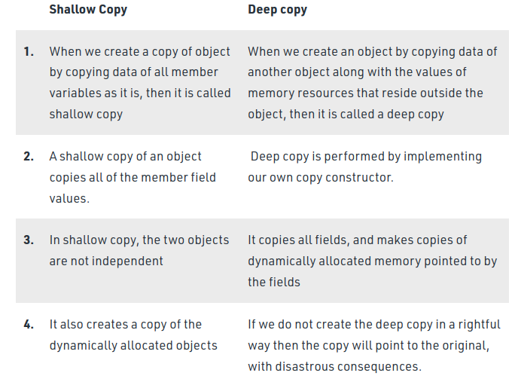

Slide 12
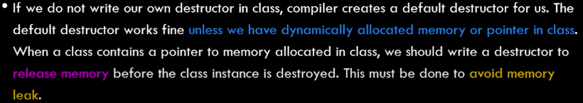
In C++ objects can be created either in stack or in heap, but in Java objects
are created only in heap.

Slide 13
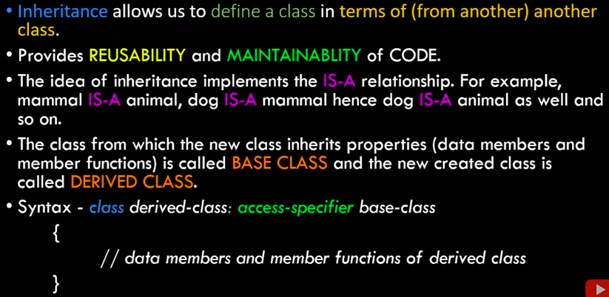
Inheritance:-

Slide 14
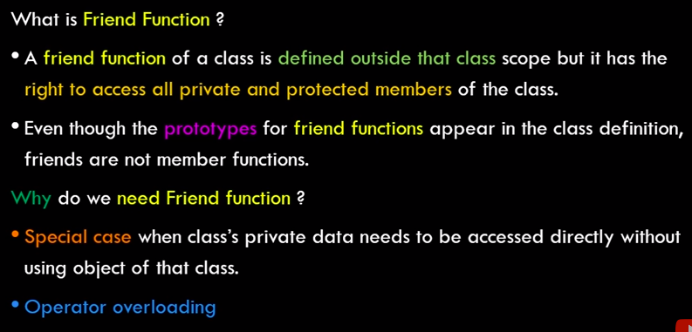

Friend Class and Function:-
Demerits:-

Slide 15
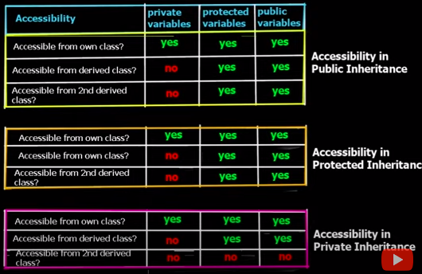
Accessibility in Inheritance:-
class derivedClassName : access_specifier baseClassName {
//inside class
};

Slide 16
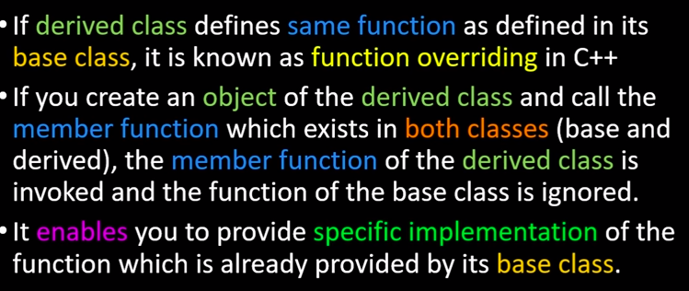
Function Overriding:
In case, the reference is of parent type and object is of child, then when
we call the function present in both parent and child, then the parent’s
function is called. To call the child’s function, we declare the parent’s
function as virtual.

Slide 17
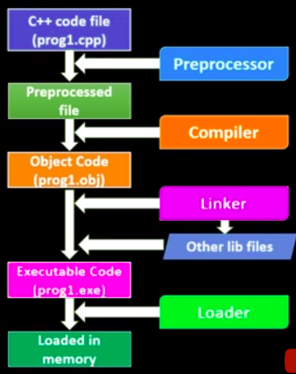
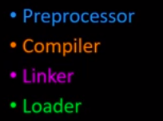
Execution of a program in C++ =>

Slide 18
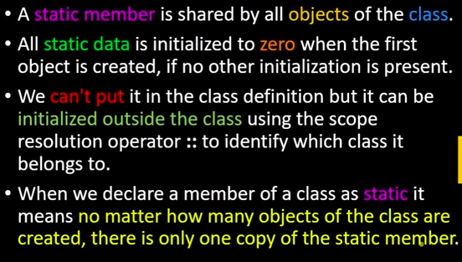
Static Data Members

Slide 19
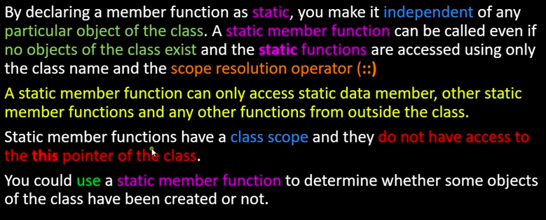
Static Member functions

Slide 20
Virtual Inheritance Technique in C++
Virtual inheritance is a C++ technique that ensures that only one copy of a base class’s member variables are inherited by second-level derivatives (a.k.a. grandchild derived classes).
Without virtual inheritance, if two classes B and C inherit from class A, and class D inherits from both B and C, then D will contain two copies of A’s member variables: one via B, and one via C. These will be accessible independently, using scope resolution.
This is a technique to solve the infamous diamond inheritance problem.

Slide 21
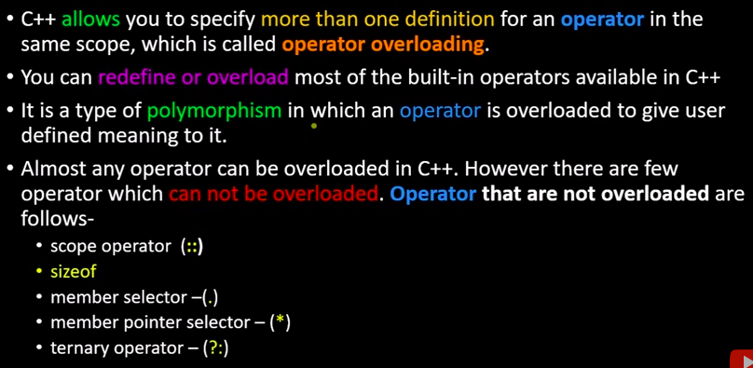
Operator Overloading ->

Slide 22
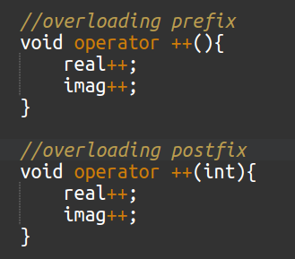
Overloading Unary Operators:-
Take the example of class of complex numbers

Slide 23
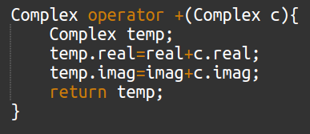
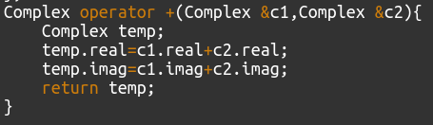
Overloading Binary Operators:-
We can also overload operators using friend function, that will take 2 arguments
In case of binary operator and one in case of unary operator.
Inside class
Outside class

Slide 24
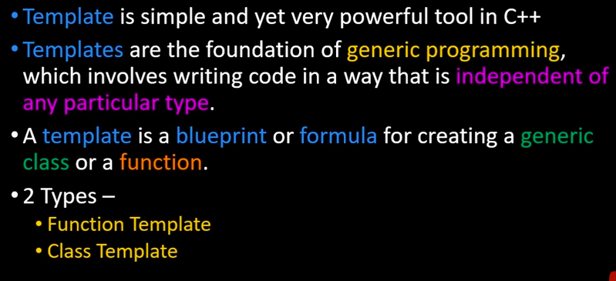
Templates in C++

Slide 25
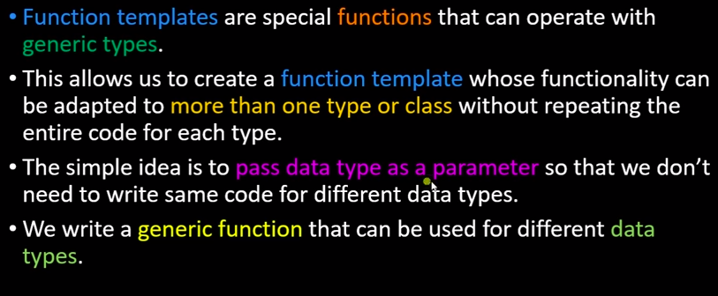
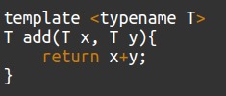


Function templates:

Slide 26
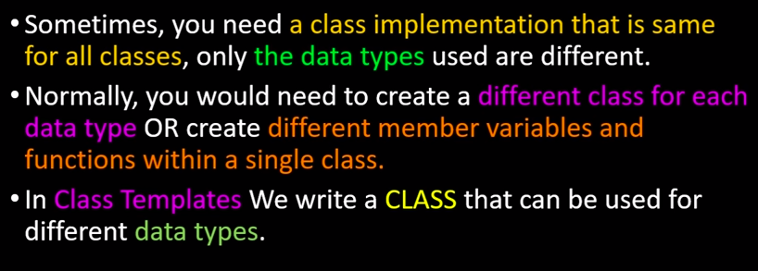
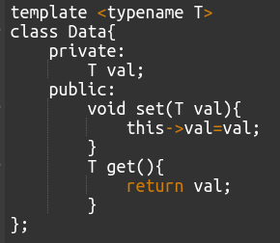
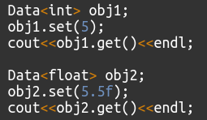
Class templates:

Slide 27
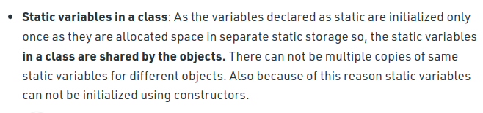
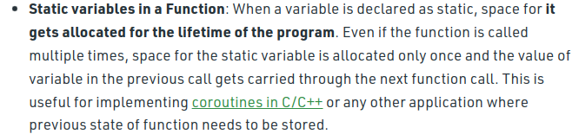
Static Keyword:

Slide 28
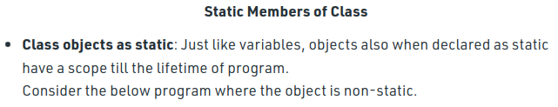
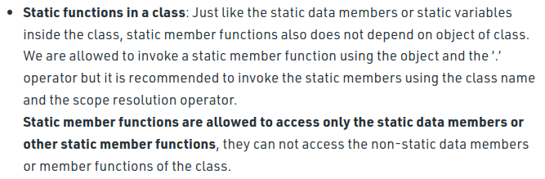

Slide 29
Practice Questions / Interview Questions
InterviewBit (OOPs)
Javatpoint (OOPs)
InterviewBit C++

